Slide 1
Charting Leadership: RESOURCES
Leader __________________________________ Role ______________________ Number of Teachers _______________
Tally each time you provide any level of coaching related to the impact of RESOURCES on development or school success. This may include references to the learning session or previous discussion, strategic questions, or personal experiences.
Circle any tally that represents a coaching episode in which you offer specific resources, or extend the discussion to include examples, anecdotes, or other connections in support of teachers focusing on this action research topic.
Date (Week or Day) | Financial | Emotional (Behavior/Persistence) | Cognitive | Spiritual | Physical (Health/Sleep/ Nutrition/Habits) | Relationships/ Role Models | Time (Wait or Completion) | Other __________ | Notes

Slide 2
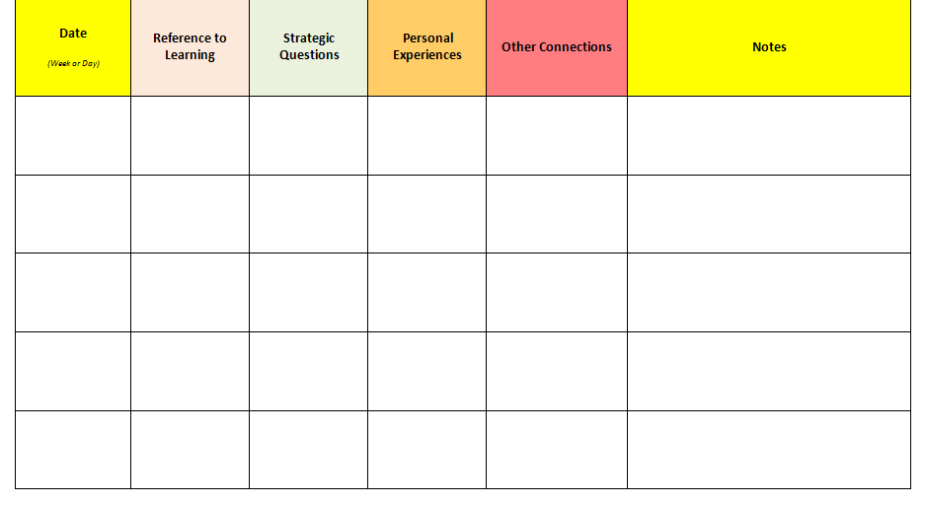
Charting Leadership: RELATIONSHIPS
Leader __________________________________ Role ______________________ Number of Teachers _______________
Tally each time you provide any level of coaching related to the impact of POSITIVE RELATIONSHIPS on development or school success. This may include references to the learning session or previous discussion, strategic questions, or personal experiences.
Circle any tally that represents a coaching episode in which you offer specific resources, or extend the discussion to include examples, anecdotes, or other connections in support of teachers focusing on this action research topic.

Slide 3
Charting Leadership: STRESS
Leader __________________________________ Role ______________________ Number of Teachers _______________
Tally each time you provide any level of coaching related to the impact of STRESS on development or school success. This may include references to the learning session or previous discussion, strategic questions, or personal experiences.
Circle any tally that represents a coaching episode in which you offer specific resources, or extend the discussion to include examples, anecdotes, or other connections in support of teachers focusing on this action research topic.

Slide 4
Charting Leadership: Status
Tally each time you provide any level of coaching related to the impact of status on child development or school success. This may include references to the learning session or previous discussion, strategic questions, or personal experiences.
Circle any tally that represents a coaching episode in which you offer specific resources, or extend the discussion to include examples, anecdotes, or other connections in support of teachers focusing on this action research topic.

Slide 5
Charting Leadership: HOPE
Tally each time you provide any level of coaching related to the impact of HOPE on child development or school success. This may include references to the learning session or previous discussion, strategic questions, or personal experiences.
Circle any tally that represents a coaching episode in which you offer specific resources, or extend the discussion to include examples, anecdotes, or other connections in support of teachers focusing on this action research topic.

Slide 6
Charting Leadership: PROACTIVE GUIDANCE
Tally each time you provide any level of coaching related to the impact of PROACTIVE GUIDANCE on child development or school success. This may include references to the learning session or previous discussion, strategic questions, or personal experiences.
Circle any tally that represents a coaching episode in which you offer specific resources, or extend the discussion to include examples, anecdotes, or other connections in support of teachers focusing on this action research topic.

Slide 7
Charting Leadership: “ME” Strategies
Tally each time you provide any level of coaching related to the impact of ME STRATEGIES on child development or school success. This may include references to the learning session or previous discussion, strategic questions, or personal experiences.
Circle any tally that represents a coaching episode in which you offer specific resources, or extend the discussion to include examples, anecdotes, or other connections in support of teachers focusing on this action research topic.

Slide 8
Charting Leadership: Goals of Behavior
Tally each time you provide any level of coaching related to the impact of understanding Goals of Behavior on child development or school success. This may include references to the learning session or previous discussion, strategic questions, or personal experiences.
Circle any tally that represents a coaching episode in which you offer specific resources, or extend the discussion to include examples, anecdotes, or other connections in support of teachers focusing on this action research topic.

Slide 9
Charting Leadership: HEALTH NEEDS
Tally each time you provide any level of coaching related to the impact of HEALTH NEEDS on child development or school success. This may include references to the learning session or previous discussion, strategic questions, or personal experiences.
Circle any tally that represents a coaching episode in which you offer specific resources, or extend the discussion to include examples, anecdotes, or other connections in support of teachers focusing on this action research topic.

Slide 10
Charting Leadership: Family & Community Engagement
Tally each time you provide any level of coaching related to the impact of FAMILY & COMMUNITY PARTNERSHIPS OR ENGAGEMENT on child development or school success. This may include references to the learning session or previous discussion, strategic questions, or personal experiences.
Circle any tally that represents a coaching episode in which you offer specific resources, or extend the discussion to include examples, anecdotes, or other connections in support of teachers focusing on this action research topic.

Slide 11
Charting Leadership: Cognitive Alignment & Rigor
Tally each time you provide any level of coaching related to the impact of COGNITIVE ALIGNMENT & RIGOR on child development or school success. This may include references to the learning session or previous discussion, strategic questions, or personal experiences.
Circle any tally that represents a coaching episode in which you offer specific resources, or extend the discussion to include examples, anecdotes, or other connections in support of teachers focusing on this action research topic.

Slide 12
Charting Leadership: INCREASING VALUE
Tally each time you provide any level of coaching related to the impact of INCREASING VALUE AS A MOTIVATING FACTOR on child development or school success. This may include references to the learning session or previous discussion, strategic questions, or personal experiences.
Circle any tally that represents a coaching episode in which you offer specific resources, or extend the discussion to include examples, anecdotes, or other connections in support of teachers focusing on this action research topic.

Slide 13
Charting Leadership: INCREASING EXPECTANCY
Tally each time you provide any level of coaching related to the impact of INCREASING EXPECTANCY FOR SUCCESS AS A MOTIVATING FACTOR on child development or school success. This may include references to the learning session or previous discussion, strategic questions, or personal experiences.
Circle any tally that represents a coaching episode in which you offer specific resources, or extend the discussion to include examples, anecdotes, or other connections in support of teachers focusing on this action research topic.

Slide 14
Charting Leadership: GROWING MINDSETS
Tally each time you provide any level of coaching related to the impact of GROWING MINDSETS on child development or school success. This may include references to the learning session or previous discussion, strategic questions, or personal experiences.
Circle any tally that represents a coaching episode in which you offer specific resources, or extend the discussion to include examples, anecdotes, or other connections in support of teachers focusing on this action research topic.

Slide 15
Charting Leadership: BACKGROUND KNOWLEDGE
Tally each time you provide any level of coaching related to the impact of BUILDING BACKGROUND KNOWLEDGE on child development or school success. This may include references to the learning session or previous discussion, strategic questions, or personal experiences.
Circle any tally that represents a coaching episode in which you offer specific resources, or extend the discussion to include examples, anecdotes, or other connections in support of teachers focusing on this action research topic.

Slide 16
Charting Leadership: EXECUTIVE FUNCTION
Tally each time you provide any level of coaching related to the impact of GROWING EXECUTIVE FUNCTION on child development or school success. This may include references to the learning session or previous discussion, strategic questions, or personal experiences.
Circle any tally that represents a coaching episode in which you offer specific resources, or extend the discussion to include examples, anecdotes, or other connections in support of teachers focusing on this action research topic.

Slide 17
Charting Leadership: MEMORY TRACE
Tally each time you provide any level of coaching related to the impact of DEVELOPING MEMORY TRACE on child development or school success. This may include references to the learning session or previous discussion, strategic questions, or personal experiences.
Circle any tally that represents a coaching episode in which you offer specific resources, or extend the discussion to include examples, anecdotes, or other connections in support of teachers focusing on this action research topic.

Slide 18
Charting Leadership: Social-Emotional Skills
Tally each time you provide any level of coaching related to the impact of Social-Emotional Skills (taught and hard-wired) on child development or school success. This may include references to the learning session or previous discussion, strategic questions, or personal experiences.
Circle any tally that represents a coaching episode in which you offer specific resources, or extend the discussion to include examples, anecdotes, or other connections in support of teachers focusing on this action research topic.

Slide 19
Charting Leadership: PURPOSEFUL INSTRUCTION
Tally each time you provide any level of coaching related to the impact of PURPOSEFUL INSTRUCTION on child development or school success. This may include references to the learning session or previous discussion, strategic questions, or personal experiences.
Circle any tally that represents a coaching episode in which you offer specific resources, or extend the discussion to include examples, anecdotes, or other connections in support of teachers focusing on this action research topic.

Slide 20
Charting Leadership: EXPLICIT INSTRUCTION
Tally each time you provide any level of coaching related to the impact of EXPLICIT INSTRUCTION on child development or school success. This may include references to the learning session or previous discussion, strategic questions, or personal experiences.
Circle any tally that represents a coaching episode in which you offer specific resources, or extend the discussion to include examples, anecdotes, or other connections in support of teachers focusing on this action research topic.

Slide 21
Charting Leadership: STRATEGIC QUESTIONING
Tally each time you provide any level of coaching related to the impact of STRATEGIC QUESTIONING on child development or school success. This may include references to the learning session or previous discussion, strategic questions, or personal experiences.
Circle any tally that represents a coaching episode in which you offer specific resources, or extend the discussion to include examples, anecdotes, or other connections in support of teachers focusing on this action research topic.

Slide 22
Charting Leadership: FORMATIVE DATA
Tally each time you provide any level of coaching related to the impact of FORMATIVE DATA on child development or school success. This may include references to the learning session or previous discussion, strategic questions, or personal experiences.
Circle any tally that represents a coaching episode in which you offer specific resources, or extend the discussion to include examples, anecdotes, or other connections in support of teachers focusing on this action research topic.

Slide 23
Charting Leadership: DOPAMINE & FUN
Tally each time you provide any level of coaching related to the impact of DOPAMINE & FUN on child development or school success. This may include references to the learning session or previous discussion, strategic questions, or personal experiences.
Circle any tally that represents a coaching episode in which you offer specific resources, or extend the discussion to include examples, anecdotes, or other connections in support of teachers focusing on this action research topic.

Slide 24
Charting Leadership: ACCOMMODATIONS
Tally each time you provide any level of coaching related to the impact of ACCOMMODATIONS on child development or school success. This may include references to the learning session or previous discussion, strategic questions, or personal experiences.
Circle any tally that represents a coaching episode in which you offer specific resources, or extend the discussion to include examples, anecdotes, or other connections in support of teachers focusing on this action research topic.

Slide 25
Charting Leadership: ARTS INTEGRATION
Tally each time you provide any level of coaching related to the impact of ARTS INTEGRATION on child development or school success. This may include references to the learning session or previous discussion, strategic questions, or personal experiences.
Circle any tally that represents a coaching episode in which you offer specific resources, or extend the discussion to include examples, anecdotes, or other connections in support of teachers focusing on this action research topic.

Slide 26
Charting Leadership: HIGH EXPECTATIONS
Tally each time you provide any level of coaching related to the impact of HOLDING HIGH EXPECTATIONS on child development or school success. This may include references to the learning session or previous discussion, strategic questions, or personal experiences.
Circle any tally that represents a coaching episode in which you offer specific resources, or extend the discussion to include examples, anecdotes, or other connections in support of teachers focusing on this action research topic.

Slide 27
Charting Leadership: TEACHER LEADERSHIP
Tally each time you provide any level of coaching related to the impact of TEACHER LEADERSHIP on child development or school success. This may include references to the learning session or previous discussion, strategic questions, or personal experiences.
Circle any tally that represents a coaching episode in which you offer specific resources, or extend the discussion to include examples, anecdotes, or other connections in support of teachers focusing on this action research topic.

