Slide 1
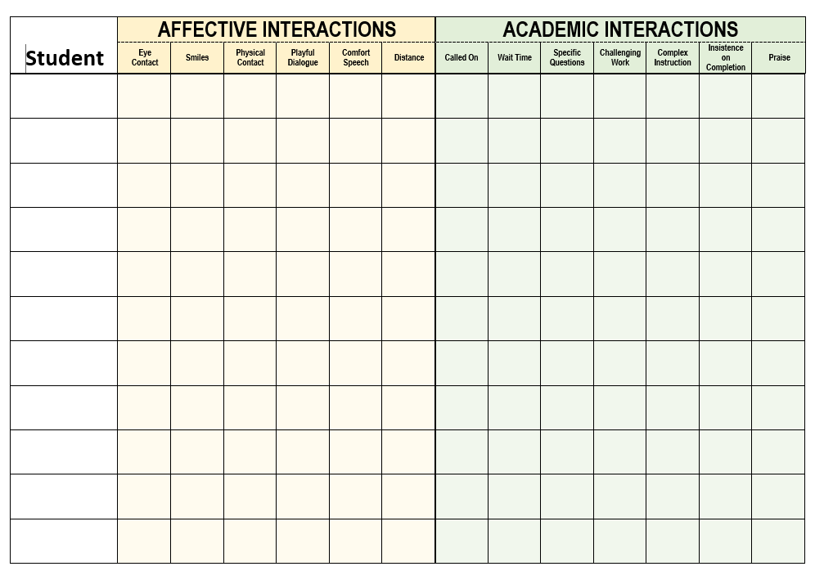
CHARTING: EXPECTATIONS

Slide 2
CHARTING: EXPECTATIONS

Slide 3
CHARTING: EXPECTATIONS

