Slide 1
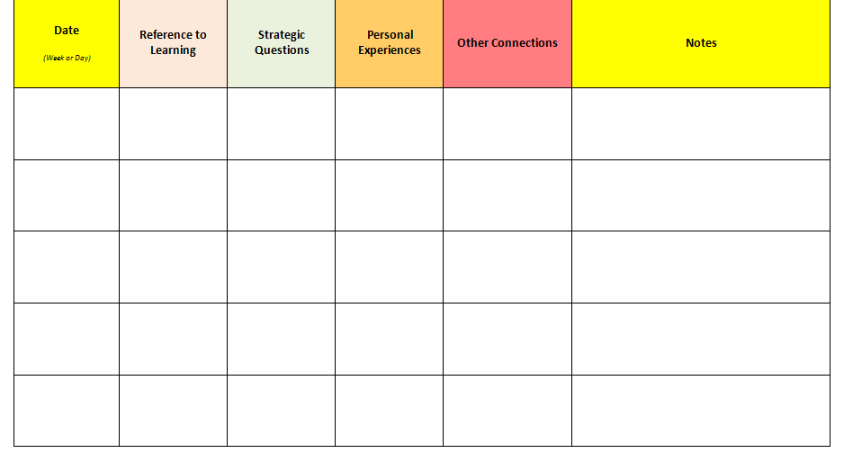
Charting Leadership: Status
Tally each time you provide any level of coaching related to the impact of status on child development or school success. This may include references to the learning session or previous discussion, strategic questions, or personal experiences.
Circle any tally that represents a coaching episode in which you offer specific resources, or extend the discussion to include examples, anecdotes, or other connections in support of teachers focusing on this action research topic.

