Slide 1
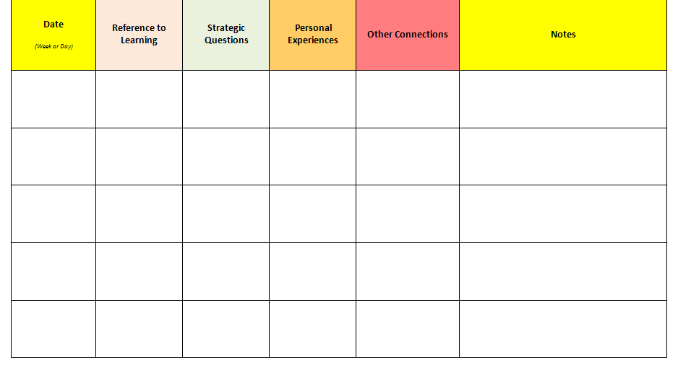
Charting Leadership: Social-Emotional Skills
Tally each time you provide any level of coaching related to the impact of Social-Emotional Skills (taught and hard-wired) on child development or school success. This may include references to the learning session or previous discussion, strategic questions, or personal experiences.
Circle any tally that represents a coaching episode in which you offer specific resources, or extend the discussion to include examples, anecdotes, or other connections in support of teachers focusing on this action research topic.

