Slide 1

– Stay in Touch –
Web – Email – Social Media
fmucenterofexcellence.org
tpawloski@fmarion.edu
@thpawloski
@CenterofExcel
#changethebrain
#teachersmattermore
#actionresearch
Why Poverty Matters
Why We Can Matter More
Francis Marion University
Center of Excellence
To Prepare Teachers of Children of Poverty
Tammy Pawloski, Ph.D.
tpawloski@fmarion.edu
Fmucenterofexcellence.org

Slide 2

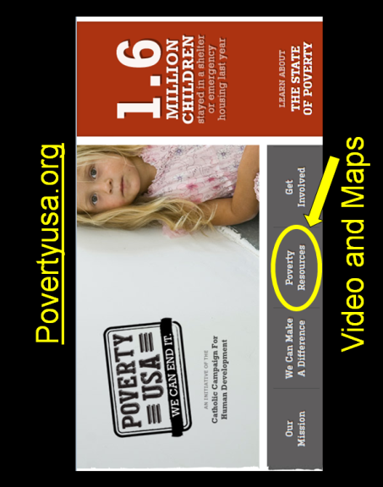
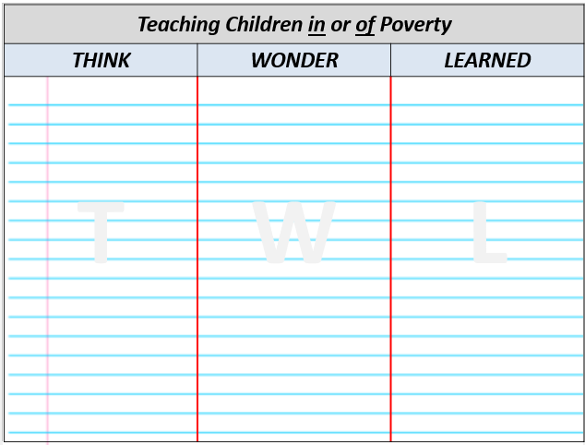
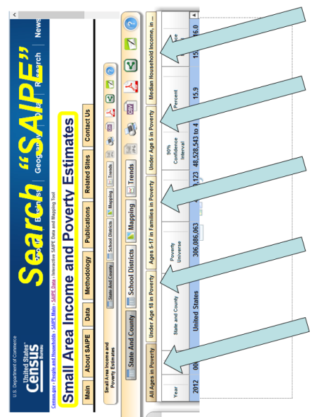
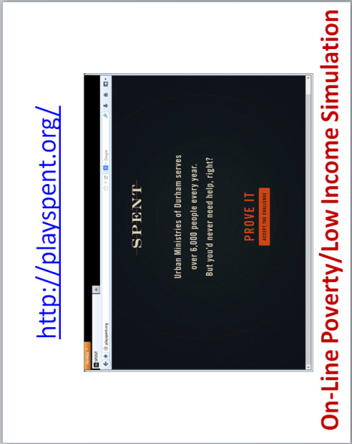
RESOURCES

Slide 3
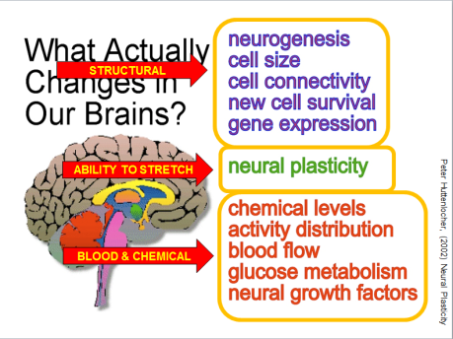
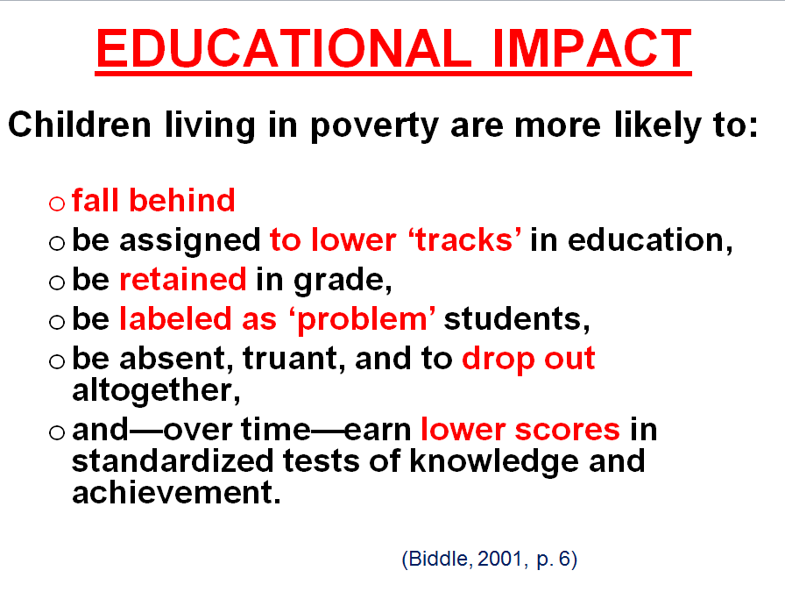

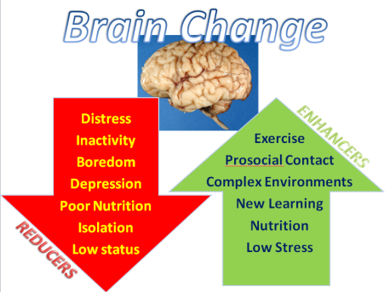
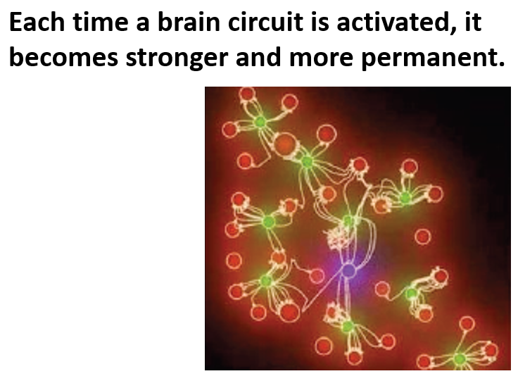
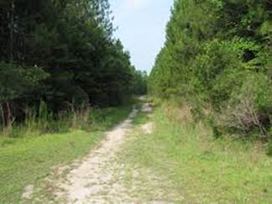
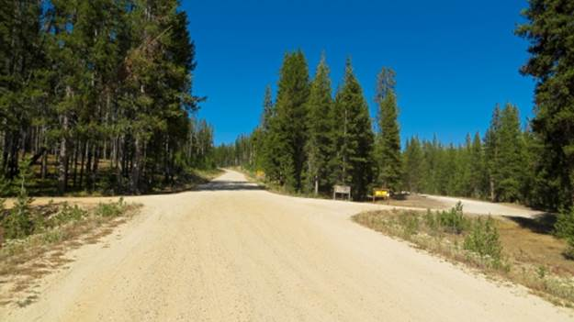
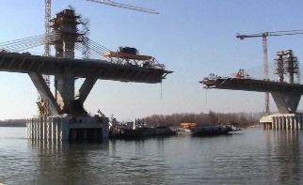

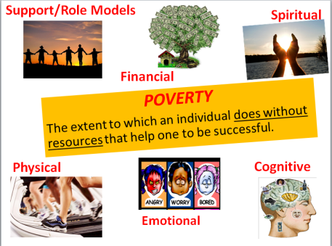

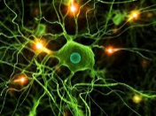
The Science of Learning
What is the science of learning?
How do brains change?
How does this change my opportunities as a teacher?
Electrical Impulses
Fire = Wire
Use…or Lose!
Now we know that brains
can and do change every day.
Change the experience, and you’ll change the brain!

Slide 4
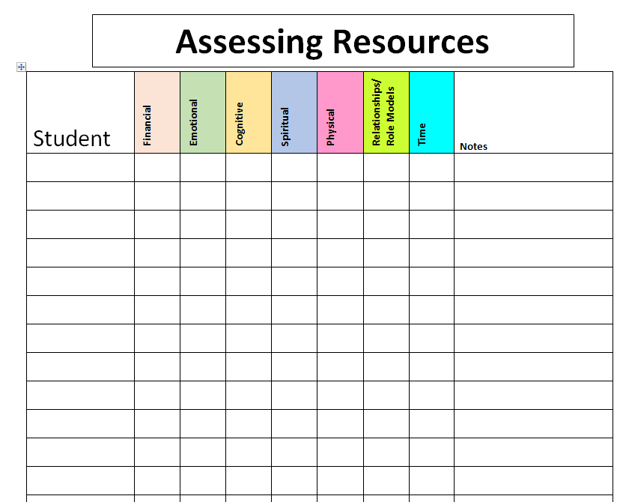
CHARTING: RESOURCES

Slide 5
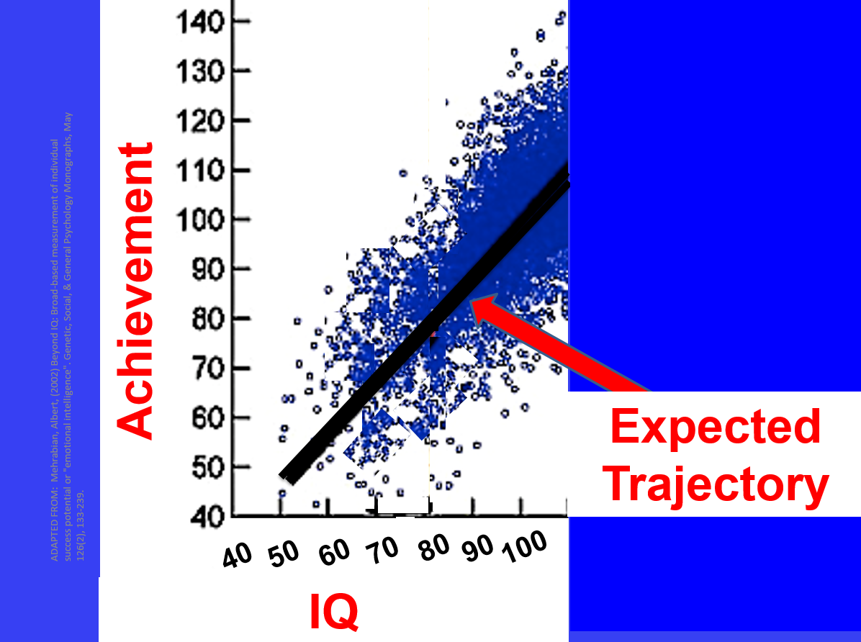


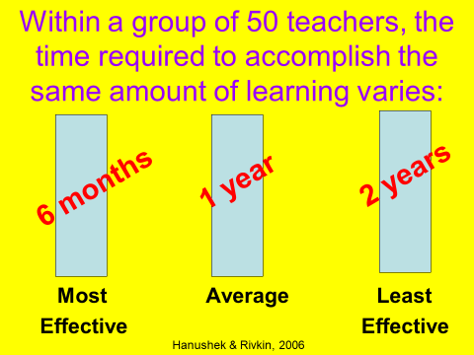
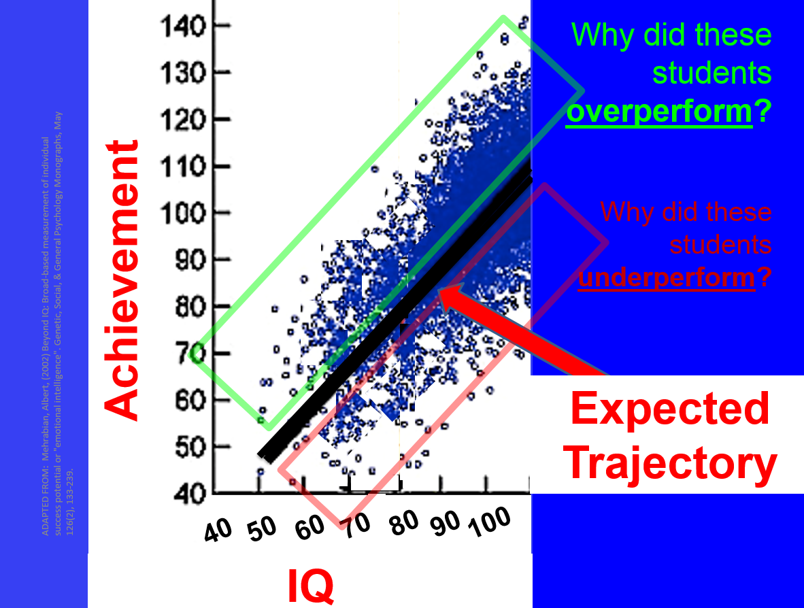
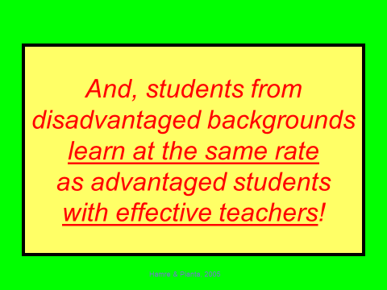
We Can Matter More!
What yields biggest returns?
WHY?
Change the experience, and you’ll change the brain!

Slide 6
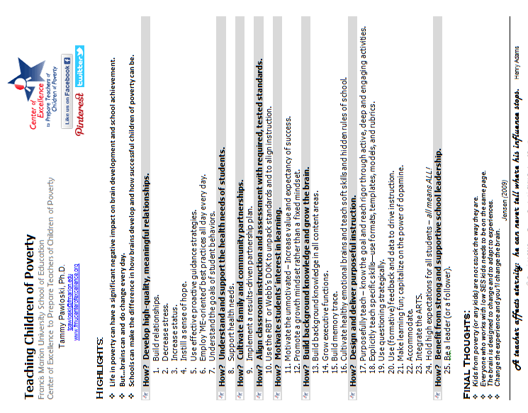

Slide 7
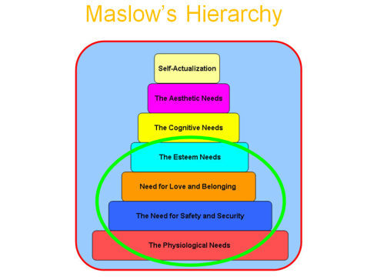


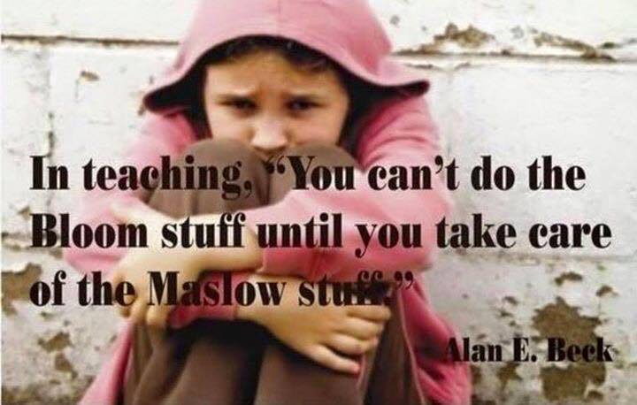
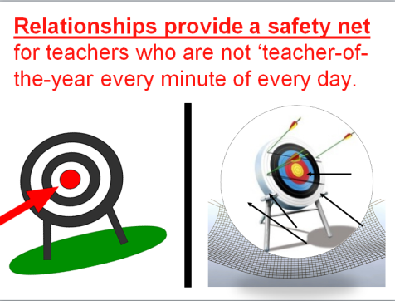
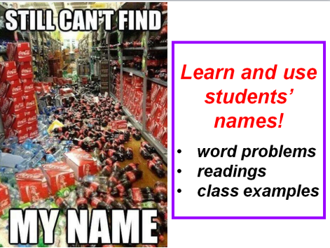
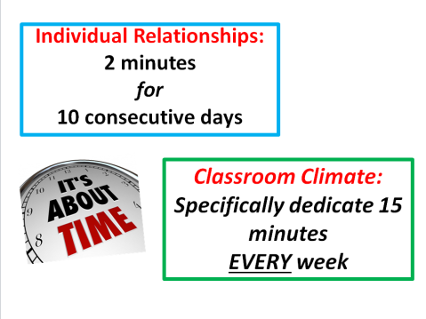
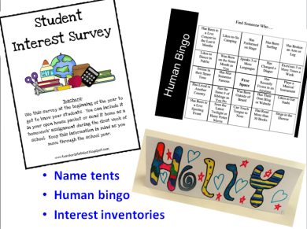
Why relationships?
What actions might I take?
Who needs my
actions?
9 out of 10 people
who get out of poverty
say it was because of a
RELATIONSHIP
1
Build RELATIONSHIPS.

Slide 8
CHARTING RELATIONSHIPS
Student | Connection |  | Possible Ways to Connect | Next Steps
 | Quality | Topics

Slide 9
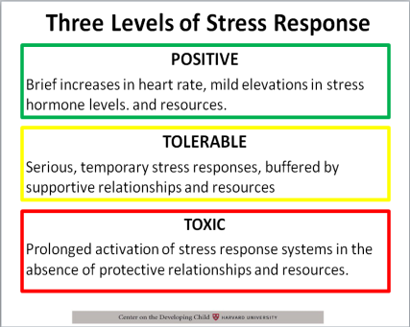
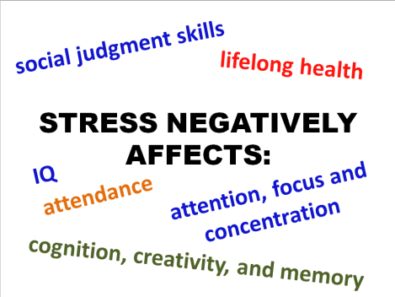

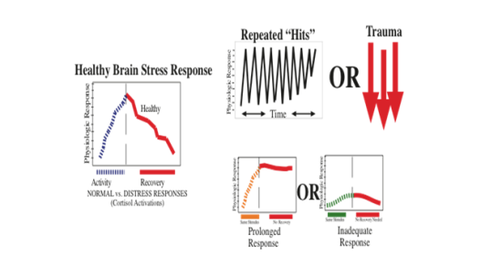
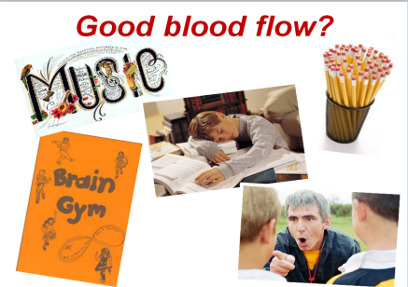

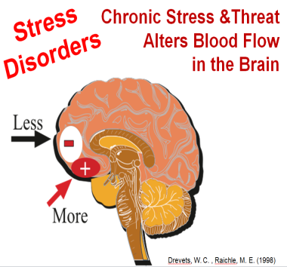
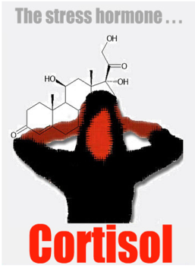
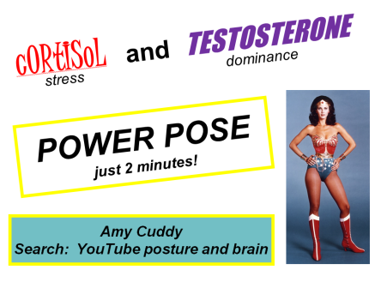
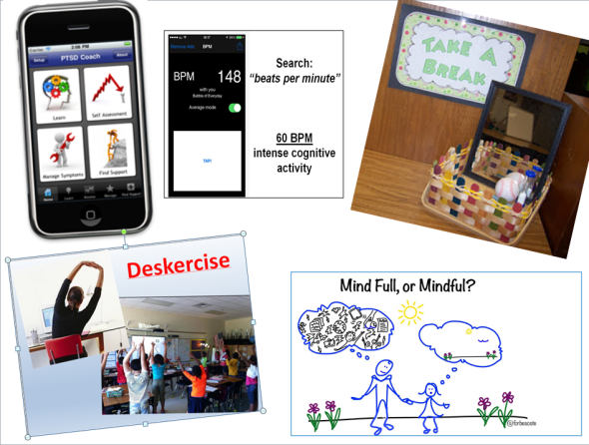
What does stress do to the brain?
What actions might I take?
Who needs my actions?
2
Decrease STRESS.

Slide 10
CHARTING STRESS
Student | Current Stress |  | Possible Stress Reducers | Next Steps
 | Level | Source

Slide 11
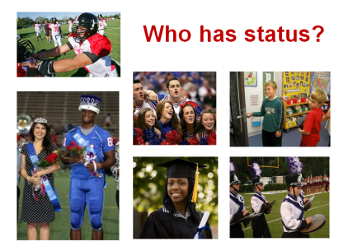
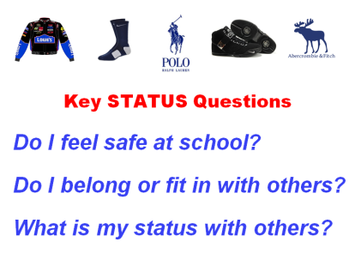


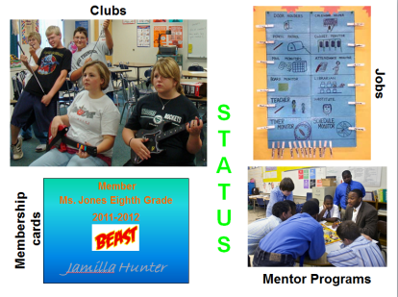
Why is status so important?
What actions might I take?
Who needs my actions?
At-Risk Youth
With Mentors
55% more likely to enroll in college
78% more likely to volunteer regularly
130% more likely to hold leadership positions
3
Increase STATUS.

Slide 12
CHARTING STATUS
Student | Current Status |  | Possible Sources of Positive Status | Next Steps
 | Quality | Source

Slide 13

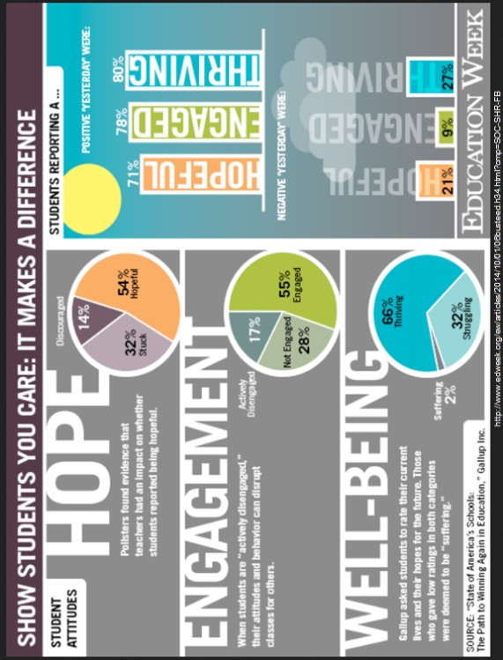

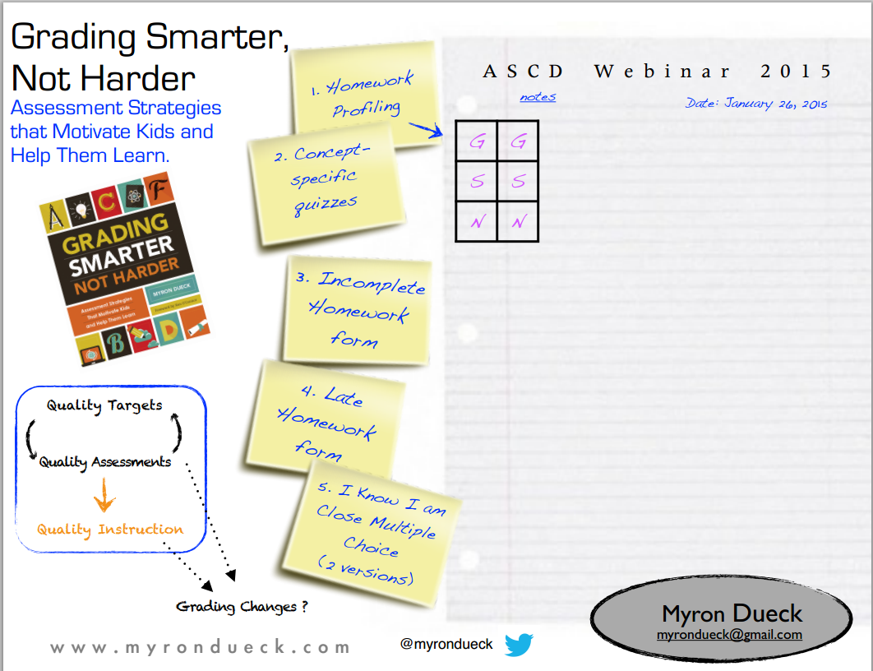
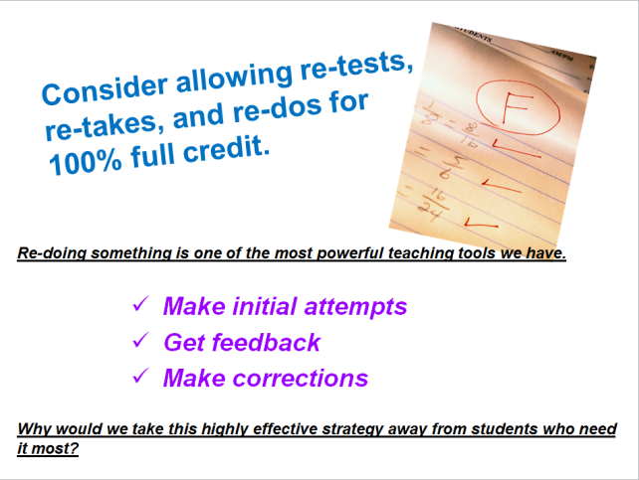
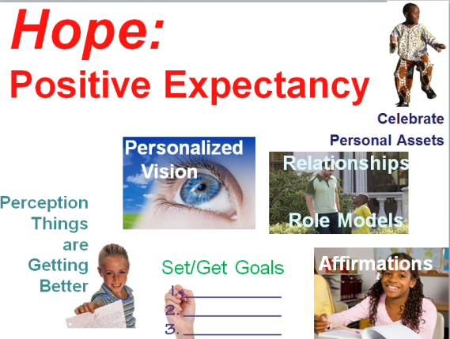

Why does hope change the brain?
What actions might I take?
Who needs my actions?
4
Increase HOPE.

Slide 14
CHARTING HOPE
Student | Hope Factors |  | Possible Strategies for Increasing Hope | Next Steps
 | Source | Value

Slide 15
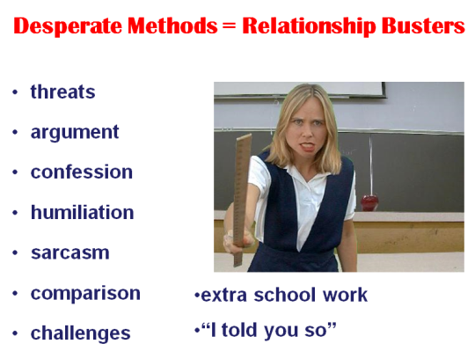

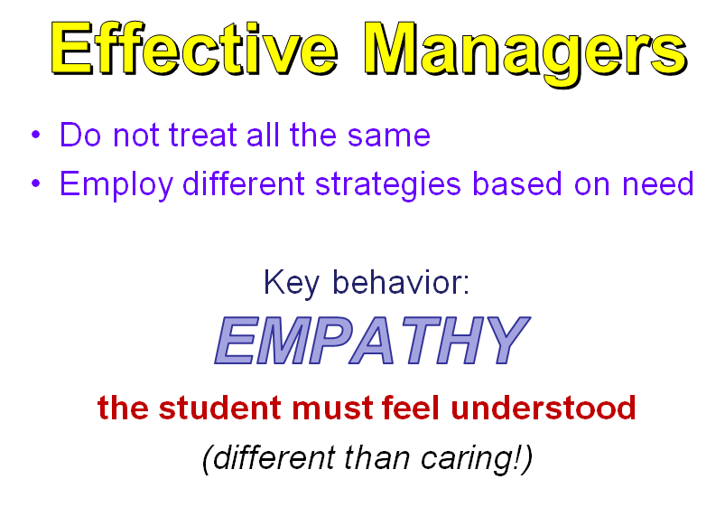
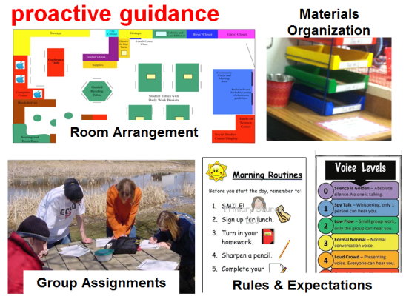


How is proactive guidance different?
What actions might I take?
Who needs my actions?
5
Utilize PROACTIVE GUIDANCE.

Slide 16
CHARTING: PROACTIVE GUIDANCE
Student | Current Strategies | Possible Proactive Alternatives | Next Steps

Slide 17
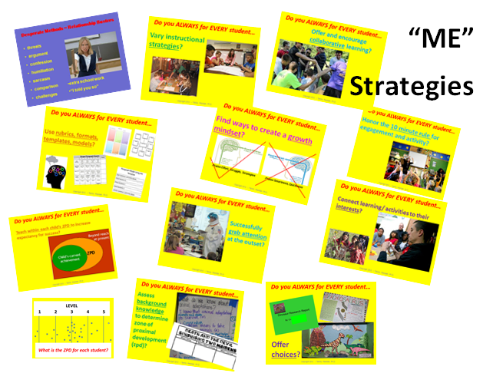

What actions might I take?
Why are “ME” strategies critical?
6
Employ ‘ME’ strategies.

Slide 18
CHARTING: “ME” STRATEGIES
Strategy | Current Use | Strategies to Try | Outcomes
Vary Instructional Strategies
Use Collaborative Learning
Use Rubrics, Formats, Templates, Models
Grow Mindsets
Follow 10 minute rule
Assess the ZPD
Assess Background Knowledge
Connect to Interests
Grab attention
Offer Choices

Slide 19

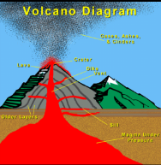
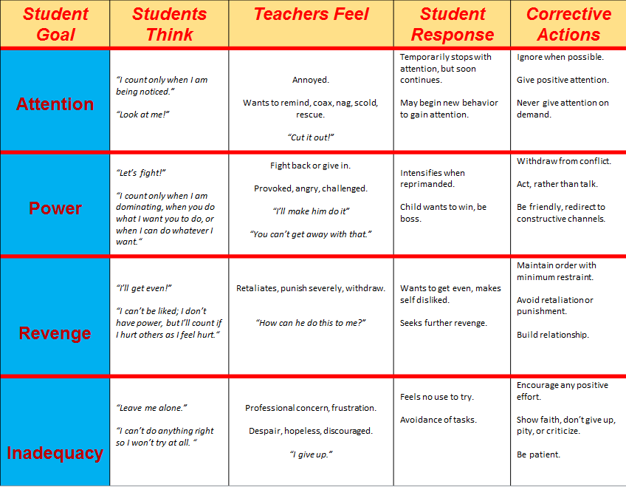

How do students’ goals change the way I view their behaviors?
What actions might I take?
Who needs my actions?
7
Understand GOALS of misbehavior.

Slide 20
CHARTING: GOALS OF BEHAVIOR
Student | Observed Behavior | My Feelings | When Corrected | Possible Goal of Behavior | Next Steps

Slide 21
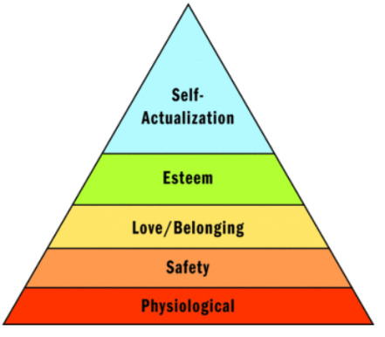

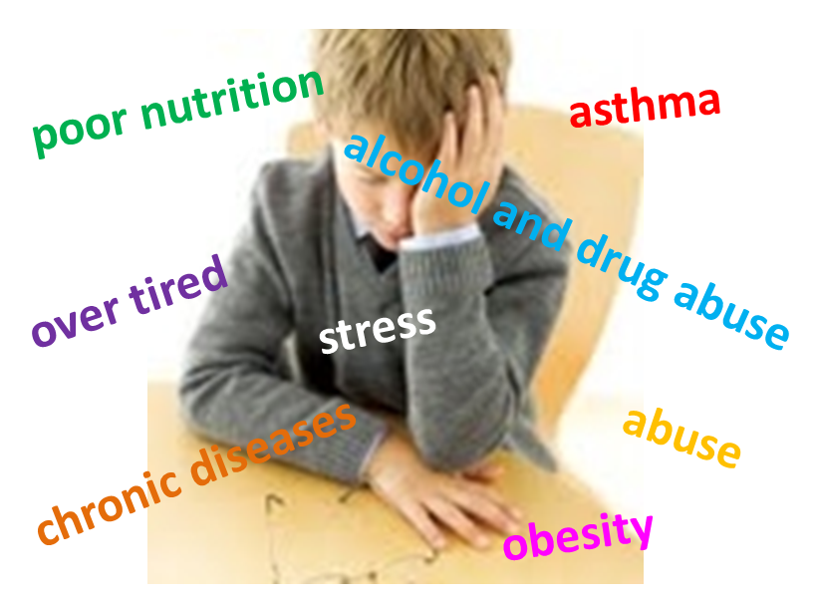
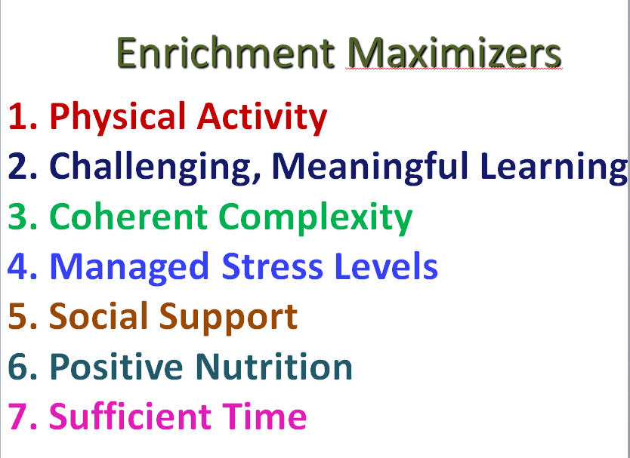
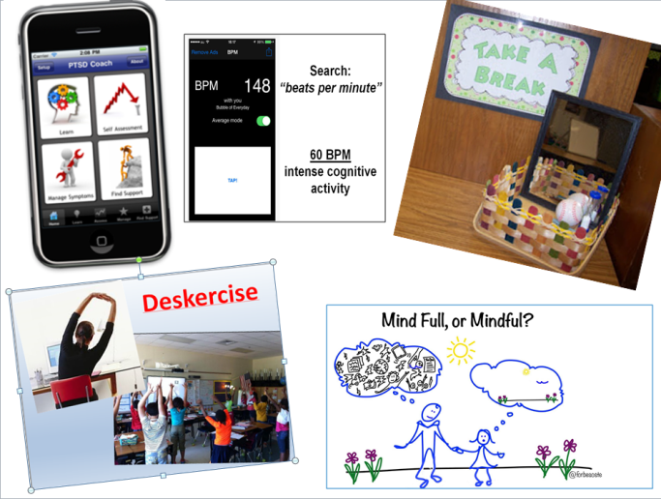



What health issues impact learning and success?
What actions might I take?
Who needs my actions?
8
Support HEALTH needs.

Slide 22




Slide 23
CHARTING: HEALTH NEEDS
Student | Nutrition | Over Tired | Stress | Asthma | Alcohol/ Drug Abuse | Obesity | Other Chronic Diseases | Abuse | Next Steps

Slide 24





Who needs my support?
Why are partnerships so important?
What actions might I take?
9
Cultivate PARTNERSHIPS.

Slide 25
CHARTING: Goal-Oriented Partnerships
Type 1 – Parenting
Goal:
Type 6 – Collaborating with Community
Type 2 – Communicating
Achievement – Behavior – Climate of Community
Type 5 – Decision Making
Type 3 – Volunteering
Epstein, J.L., et.al. School, Family, and Community Partnerships: Your Handbook for Action(2ndedition), Corwin, Thousand Oaks, CA, 2002.
Type 4 – Learning at Home

Slide 26





Why is alignment
important?
What type of thinking is required?
What actions might I take?
10
How deeply do you have to know the content?
ALIGN instruction and assessment.

Slide 27
CHARTING: ALIGNING INSTRUCTION WITH STANDARDS
Standard
Revised Bloom’s Taxonomy |  | Webb’s Depth of Knowledge
Cognitive Level |  | Rigor Level
Justification |  | Justification
Type of Knowledge |  | Instructional Strategies
Justification

Slide 28







What influences motivation?
What actions might I take?
Ask yourself…
Would you be teaching to an empty room if they did not have to be there?
How important is VALUE?
It is
neurobiologically impossible
to think deeply about things
you do not care about!
Who needs my support?
11
MOTIVATE.

Slide 29


Slide 30
CHARTING: VALUE
Student | Current Value for Learning | Evidence | Possible Strategies for Increasing Value | Next Steps

Slide 31
CHARTING: EXPECTANCY OF SUCCESS
Student | Current Expectancy of Success | Evidence | Possible Strategies for Increasing Expectancy | Next Steps

Slide 32









Why are growth mindsets important?
How do mindsets develop?
What actions might I take?
12
Promote GROWTH MINDSETS.

Slide 33
CHARTING MINDSETS
Student | Current Mindset |  | Possible Strategies for a Growth Mindset | Next Steps
 | Growth or Fixed | Evidence

Slide 34







What is background knowledge and
how does it impact school success?
What actions might I take?
Who needs my support?
13
Build BACKGROUND KNOWLEDGE.

Slide 35
CHARTING: BACKGROUND KNOWLEDGE
Student | Current Understanding | Possible Ways to Build Background Knowledge | Next Steps

Slide 36






Who needs my support?
How do executive functions influence school and life success?
What actions might I take?
14
Grow Executive Function.

Slide 37


Slide 38










What is memory trace and why does it matter?
What actions might I take?
Who needs my support?
15
Build MEMORY TRACE.

Slide 39
CHARTING: MEMORY TRACE
Student | Current Abilities | Possible Memory Building Strategies | Next Steps

Slide 40









What are soft skills and hidden rules and why do they matter?
What actions might I take?
Who needs my support?
16
Teach SOFT SKILLS and Hidden Rules.

Slide 41
CHARTING: EMOTIONAL SKILLS, SOFT SKILLS, HIDDEN RULES
STUDENT | Humility | Forgiveness | Empathy | Optimism | Compassion | Sympathy | Patience | Shame | Cooperation | Gratitude | Sadness | Joy | Disgust | Anger | Surprise | Fear | NOTES

Slide 42









What is purposeful instruction?
What actions might I take?
RIGOR is more than…
Memorizing
Reciting
Restating
QUALITY, not QUANTITY!
17
PURPOSEFULLY teach.

Slide 43
CHARTING: PURPOSEFUL INSTRUCTION
Skill / Lesson | Current Strategies | Ways to Increase Rigor/Depth | Next Steps

Slide 44








What should be explicitly taught and why?
What actions might I take?
Who needs my support?
18
EXPLICITLY teach.

Slide 45
CHARTING: EXPLICIT INSTRUCTION
Skill / Lesson | Current Strategies | Ways to More Explicitly Teach | Next Steps

Slide 46





Clarifying questions Help us better understand what has been said.
Adjoining questions Used to explore related aspects of the problem that are ignored in the conversation.
Funneling questions Used to dive deeper; asked to understand how an answer was derived, to challenge assumptions, and to understand the root causes of problems.
Elevating questions Raise broader issues & highlight biggest picture; help zoom out.
INSTEAD OF ‘I DON’T KNOW’:
May I please have some more information?
May I have some more time to think?
Would you please repeat the question?
Where could I find information about that?
May I consult an expert?
May I ask a friend for help?
May I poll the class?
May I have a clue or fifty-fifty?
What questioning strategies yield best results?
What actions might I take?
Who needs my support?
Say more about that….
Give an example….
Tell me why you think that….
I might agree but I need more...
What do you think?
Why do you think that?
How do you know this?
Can you tell me more?
What questions do you still have?
19
Use Questioning strategically.

Slide 47
CHARTING: QUESTIONING STRATEGICALLY
Skill / Lesson | Current Questions | Ways to Elevate Questions for Depth | Next Steps

Slide 48






FORMATIVE vs. SUMMATIVE
FOR INSTRUCTION SUM of INSTRUCTION
What data is available and how should it be used?
What actions might I take?
20
Use Feedback and DATA.

Slide 49
CHARTING: USING FORMATIVE FEEDBACK & DATA
Skill / Lesson | Current Data |  | Ways to Use Formative Feedback & Data | Next Steps
 | Source | Use

Slide 50




Why does the brain respond to fun?
What actions might I take?
Who needs my support?
21
Make learning FUN.

Slide 51
CHARTING: DOPAMINE & FUN
Skill / Lesson | Current Strategy | Ways to Elevate Dopamine & Fun | Next Steps

Slide 52


What accommodations might make the difference for my students?
What actions might I take?
Who needs my support?
22
ACCOMMODATE.

Slide 53
CHARTING: ACCOMMODATIONS
Student | Parental Support | Prioritizing | Organizational Skills | Transportation | Short Term Memory | Anything that Costs Money | Medical/Health Needs | Emotional/Social Regulation | Next Steps

Slide 54









Drop-out Rate Low-SES
High Low
Arts Participation Rate
Students in Arts:
More Likely!
Math and Science Fair: 4 x More
School Attendance Award: 3 x More
Academic Recognition: 4 x More
Elected to Class Office: 3 x More
LOW SES STUDENTS IN ARTS
More than
2 times
as likely to
graduate college
Who needs my support?
Why are the ARTS so important?
What actions might I take?
23
Integrate the ARTS.

Slide 55
CHARTING: INTEGRATE ARTS
Skill / Lesson | Current Strategy | Ways to Integrate Arts | Next Steps

Slide 56





How do expectations impact learning?
What actions might I take?
Who needs my
actions?
5% -10% of
student achievement performance
may be ascribed to the influence of
differential
teacher expectations.
(Brophy, 1983)
24
Hold HIGH EXPECTATIONS.

Slide 57

CHARTING: EXPECTATIONS

Slide 58
CHARTING: EXPECTATIONS

Slide 59
CHARTING: EXPECTATIONS

Slide 60








How can teacher and school leaders change the course of education?
What actions might I take?
25
LEAD or FOLLOW.

Slide 61
CHARTING: TEACHER LEADERSHIP
Ways I Can Lead | I am good at: | I want to learn more about:
Resource Provider
Instructional Specialist
Curriculum Specialist
Classroom Supporter
Learning Facilitator
Mentor
School Leader
Data Coach
Catalyst for Change
Learner

Slide 63


Slide 64


